Slide 1
Interactive Physics-Based Animation – Part 2
Pauline Belford

Slide 2
Introduction
Creating complex objects
Joints
Spring
Hinge
Character
Altering object properties through use of scripting
Raycasting
Standard Assets
Physics Materials

Slide 3
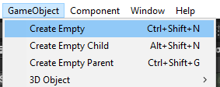

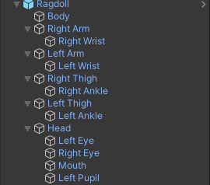
Building Complex Objects
We can create more interesting objects by combining the basic shapes.
You can create an Empty Parent Object from the drop-down menu.
Objects can be added to the regular hierarchy, then dragged and dropped into the parent object in the hierarchy to create a parent-child link.
You can add many objects to a parent, and those objects can have their own child objects using the same drag and drop technique.

Slide 4
Building Complex Objects
When an object is a child of a parent object, its co-ordinates are no longer world-space co-ordinates.
They are relative to the centre of the parent object.
This has to be the case, otherwise the movement calculations become unnecessarily complex.
You need to think carefully about the object hierarchy.
If forces will be applied, how do you want those to function?
For example, a ragdoll’s limbs function in a more realistic way if they are children of the parent object rather than of the body.
This is because you want forces to act on them independently of the body. Strange things happen otherwise.

Slide 5
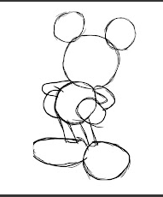
Approximating Complex Objects from Basic Shapes
This method of designing objects is not sophisticated.
But it works for our illustrative purposes.
Do you recognise the character in the image?
This famous character is created from a small set of spheres and cylinders.
http://ollienicholls88.blogspot.com/2012/03/using-basic-shapes.html

Slide 6
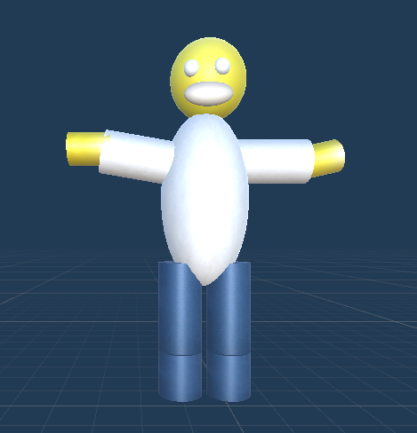
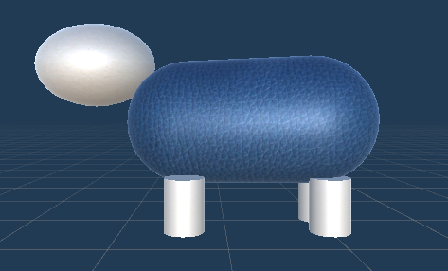
One Man and his Dog

Slide 7
Approximating complex objects
If we just want the object to move as a whole, we can stop there.
But how likely is it that you just want an object that has no moveable parts?
If we want the parts to be able to function independently, we need to link them using joints.
Joints are components to express a relationship between two rigid bodies.
For example, two objects are connected by a spring.
Or one object rotates around the pivot of another object, like the hinge of a door.

Slide 8
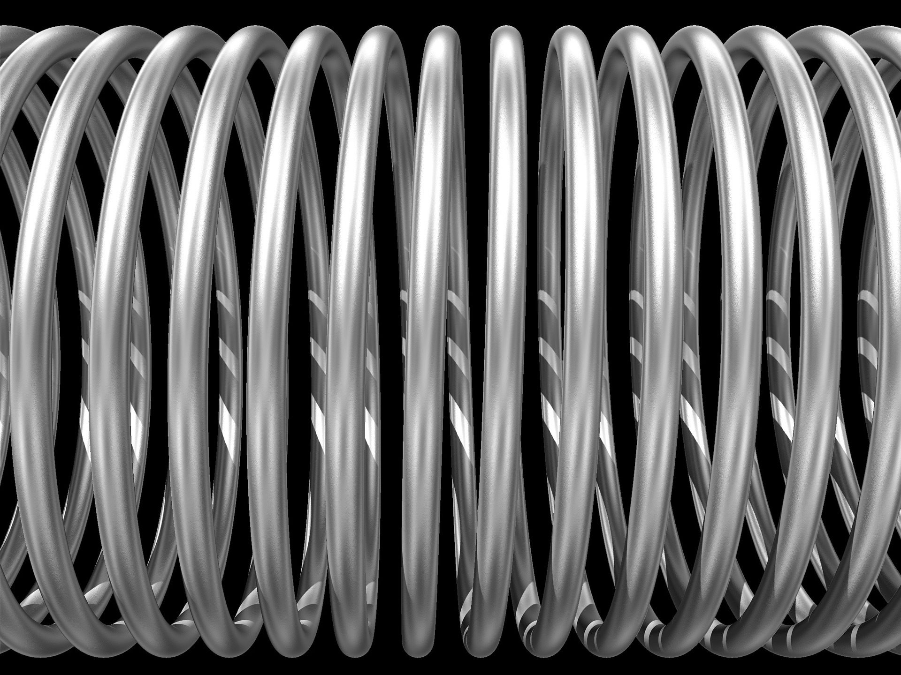
What is a spring?
Spring is a word that has many different meanings.
In our context, we are interested in coil springs. These are objects which store mechanical energy. They can be compressed – which stores energy - and then bounce back.
They are often used in vehicle suspensions, mechanical watches, locks, mattresses amongst many other uses.
Often used as shock absorbers.

Slide 9
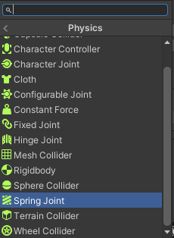
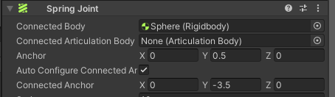
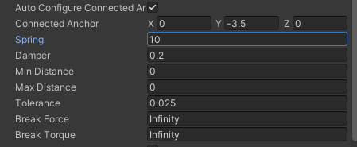
Spring Joints Example in Unity
Add two spheres. The first at (0,4,0) and the second at (0,0,0).
Add rigidbody components to both spheres.
Make the top sphere kinematic.
Attach a spring joint to the second sphere.
Set the Connected Body to be the top sphere, by dragging and dropping it from the hierarchy into the Connected Body parameter.
This should get the anchor point correct if Auto Configure Connected is checked, but double check it acts as expected.
Add more spheres, connecting each one to the one above. What impact does this have on the other spheres?
Change the mass of the spheres so they have unequal weights. What impact does this have?
Change other parameters so the springs are more or less soft, or can be broken with force or torque. What impact do these values have?

Slide 10
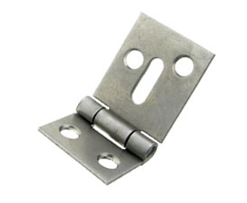
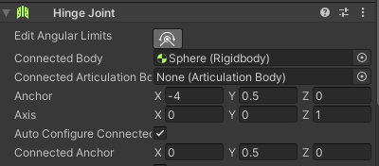

What is a hinge?
Hinges are joints where one object rotates around the axis of another on just one axis.
For example a hinged door.
For example a finger joint.
For example in a folding table.
The movement of objects attached using these types of joints, when forces are applied to them, are more restricted than those of spring joints in terms of range of motion.
We can also set the angular limits. (The hinge may be the full 360 degrees or it may only allow a very limited range.)

Slide 11
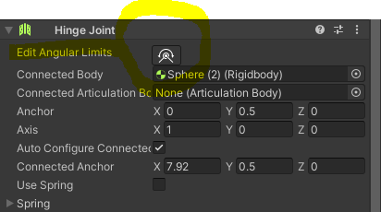

Hinge joint simple example
Join spheres together using hinge joints.
Double check the anchor points.
View from different perspectives to see the difference with spring joints.
Try changing the mass of the spheres, the angular limits of the hinges, and the force required to break the joints. What impact do these changes have?

Slide 12
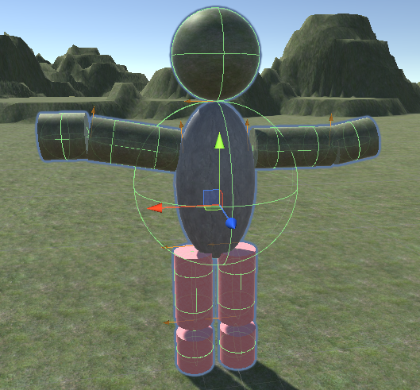
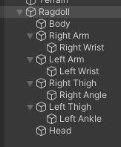
Ragdoll from hinge joints
Ragdolls are more interesting examples than spheres.
The human body has many hinge joints.
Finger joints
Knee joints
Elbow joints (kind of)
Maybe we could use them in a ragdoll object?
Play about with the hinge joint parameters.
Does the ragdoll (and its limbs) behave in a realistic manner?

Slide 13
Ragdoll with Character Joints
Our ragdoll with hinge joints behaved in an interesting way.
But the impact of the forces was not always realistic.
Character joints are ball and socket type joints which should be more realistic for ragdolls of humans or other mammals.
Finding the anchor points for these joints is more complex (and frustrating) than for the Spring and Hinge joints.
Unity’s editor will often attach them to the wrong side of the object, and you have to largely guess at the correct coordinates.
It is possible to copy and paste coordinates from elsewhere, which may help.
E.g. if you get the anchor point correct for one leg, copy and paste for the other, then mirror the relevant coordinate to find the anchor point for the other leg.
Make sure that any changes you make to the ragdoll are done using the Prefab, not to an individual instance of it.

Slide 14

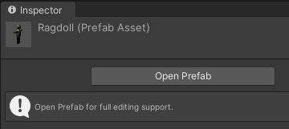
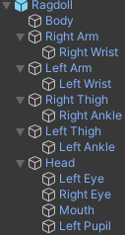
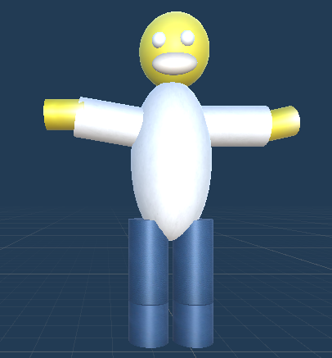
Ragdoll with Character Joints
Make sure that any changes you make to the ragdoll are done using the Prefab, not to an individual instance of it.
Select the prefab icon from the Project window. This will enable you to Open Prefab in the Inspector window, and the ragdoll will be shown as the only item in the hierarchy, with a blue background rather than the scene background.
Play about with the joints parameters such as break force and angular limits, and the mass of the ragdoll parts. Bounciness is also an interesting one.

Slide 15
Ragdoll Actions
Most of what we have looked at so far required little to no code.
This is still true, but there is some code behind the ragdolls.
Ragdolls are not designed to fit into a standard game loop.
You can spend a lot of time setting up a ragdoll so it can walk, climb stairs etc., but it is very difficult to do.
Solution/ workaround: treat the ragdoll like a stunt double.
These ragdolls are intended to be illustrative/ proof of concept, not realistic.
For that, you would need more objects, more joints, more thought over degrees of movement etc. (And better artistic skills.)
When it gets to the point that the character should ragdoll, then set all the children to kinematic.
They have to be non-kinematic to start with otherwise forces act on them and they ragdoll against gravity.

Slide 16
Ragdoll Script – Part 1
Tags the parent object and makes the parent object kinematic
If it is not empty
Finds all its child objects and sets them as kinematic.
When the player clicks on the screen, perform a Raycast.
This draws a line from where you’ve clicked, straight into the screen.
This checks to see if the click has hit any objects in the scene.
Pass in the ray and pass out a reference value
So that when the value changes in the function it changes for real

Slide 17
Ragdoll Script – Part 2
If the ray does hit something
Get the collider of what was hit
Then get the associated game object of that collider
Get the parent object and get its rigidbody.
If there was a rigidbody, set the kinematic value to false so that it can ragdoll
Then apply a force to it.

Slide 18
Raycasting
Raycasting has been used in this script rather than colliders.
Raycasting casts an invisible ray from a particular location.
It then tells us if the ray is intercepted by any other object.
If so, we can find out what the object(s) are and add them to a list.
We can then use this to trigger an action via a script.
We can use this for many purposes.
Gunfire
Line of sight
Aiming

Slide 19
Raycasting
Why use Raycasting?
Imagine you want a game with a sniper rifle
Like our ragdoll game, if we move the player much further from the ragdolls.
We could dynamically create dozens or hundreds of bullets, all with their own colliders, and work out an accurate travel path for them based on line of sight, trajectory, external forces like wind and gravity…
Really though, you probably just want to check if the player is firing at the right thing.
In such situations, raycasting is much less resource intensive than bullet generation and collision checking.
Raycasting could also be used as a tripwire mechanism.
Or we could use a trigger.
Which is better depends on the circumstances.

Slide 20

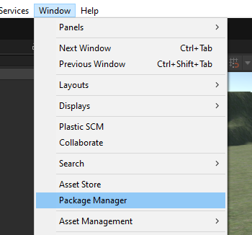
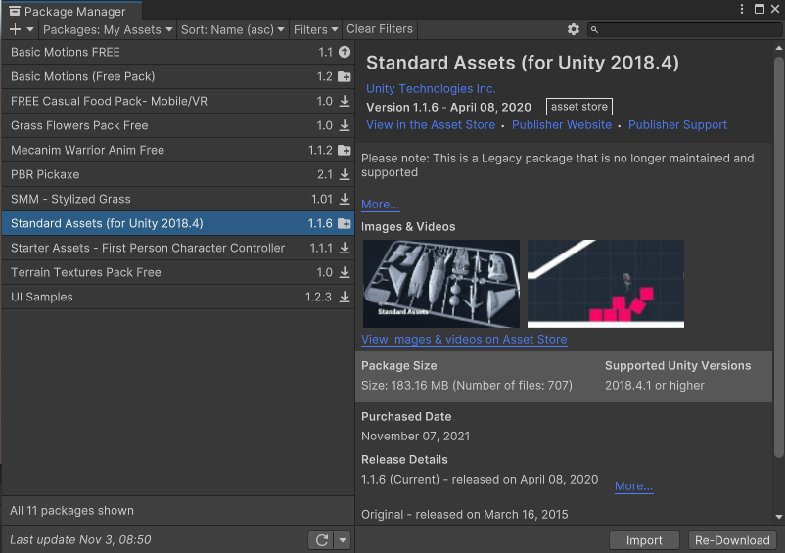
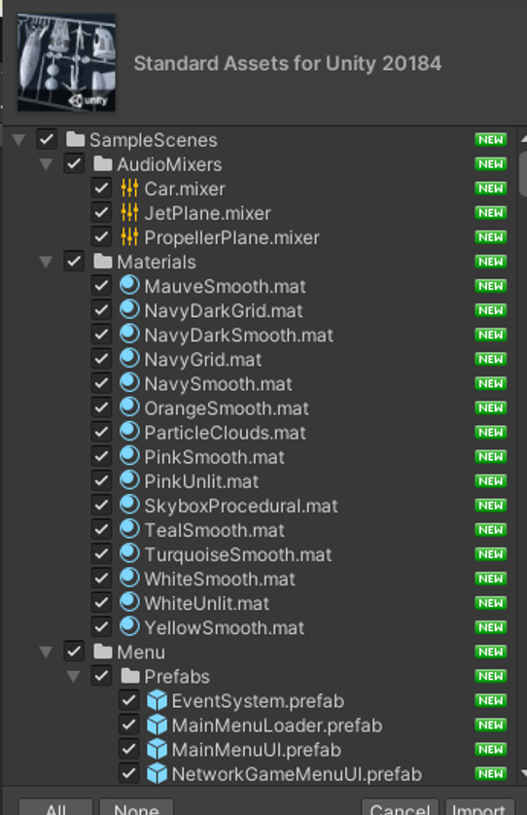
Standard Assets
We can make changes to our ragdoll (and any object) through the use of Physics Materials.
The Standard Assets pack is available on the Unity Asset Store, and contains some standard physics materials.
It also contains some basic terrain textures and a FirstPersonController, amongst other things.
To make use of standard assets, we have to download and import the package, then make a couple of changes to scripts.
https://obenkyolab.com/?p=2048&lang=en

Slide 21
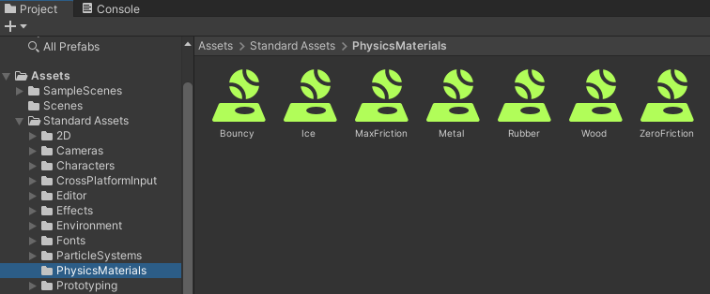
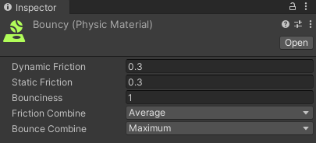
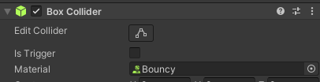
Standard Assets Physics Materials
These are found in a subfolder of the Standards Assets, once you import these into a project.
Physics materials are applied to the colliders.
Using the usual drag and drop motion.
Experiment with what these do.

Slide 22
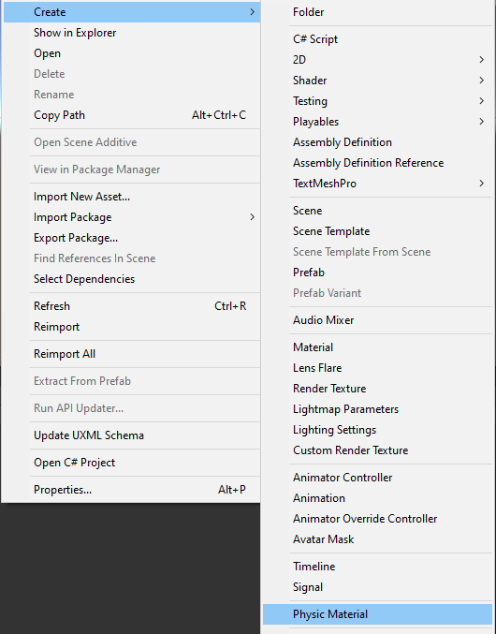
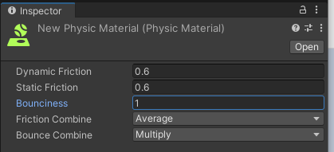
Create Your Own Physics Materials
If none of the standard materials do exactly what you want, you can also create your own custom physics materials.
Got to Assets → Create → Physic Material
This will create a New Physics Material in your Project Assets.
Add it to a suitable folder.
Give it a suitable name.
Click on it to open it in the Inspector Window, and experiment with the parameters.

Slide 23
Summary
In this Lecture we have covered the following:
Creating complex objects
Joints
Spring
Hinge
Character
Altering object properties through use of scripting
Raycasting
Standard Assets
Physics Materials

